Slide 1

HackVortex 2025 - CollegeConnect
"Find Your Perfect College Experience"
A unified platform for college communities by Team IGNOU Duomates.

Slide 2
The Problem: Disconnected Campuses
Challenge
Impact
No centralized platform
Disorganized communication
Students miss updates
Missed opportunities
Admins face inefficiencies
Reduced engagement
No seamless role-based interaction
Administrative inefficiency

Slide 3




Our Solution: CollegeConnect
Android App
Role-based access for students/admins.
Firebase Integration
Real-time data, secure authentication.
Material Design UI
Intuitive, modern interface.

Slide 4
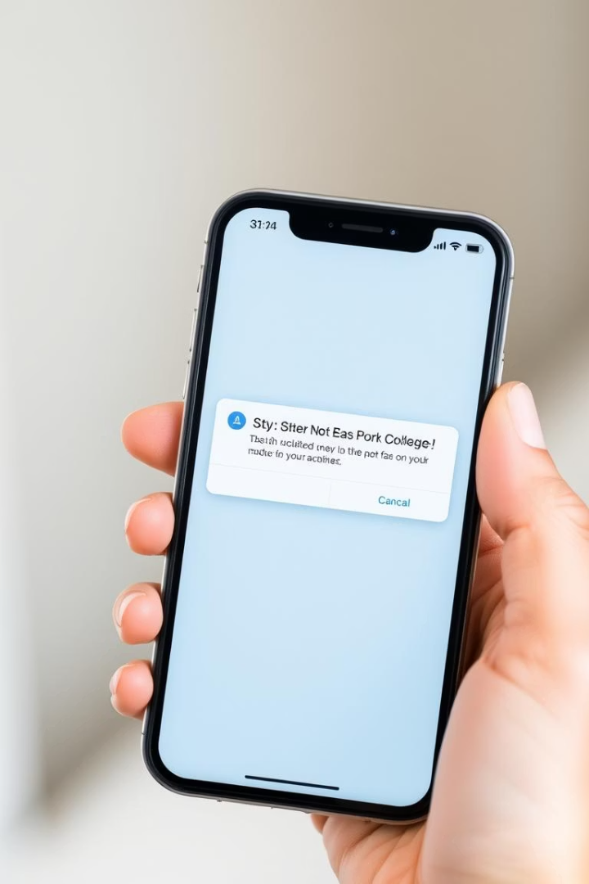
Key Features
User Profiles
Announcements
Role-based (Student/Admin) with name, email, image.
Admins post, students view real-time updates.
Real-time Notifications
Instant alerts for new announcements.

Slide 5

Technology Stack
Frontend
Android (Java), Material Design
Backend
Firebase, Realtime Database
Authentication
Firebase Authentication
Image Loading
Picasso Library
Development
Android Studio IDE
Platform
Android API 21+

Slide 6
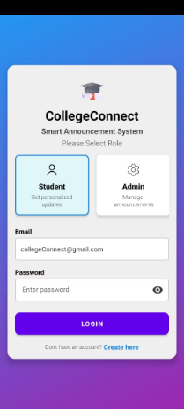
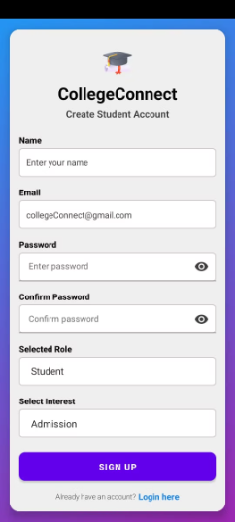
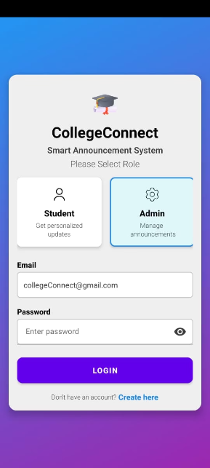
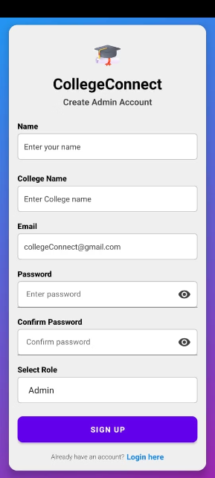
App Screenshots
Login Page
With Selected Role as Student
Student Signup
Login Page
Admin Signup
With Selected Role as Admin

Slide 7
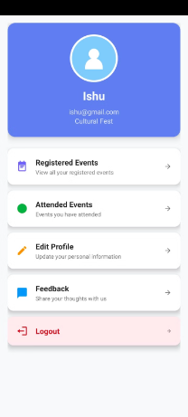
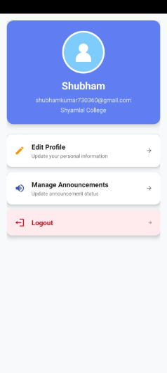
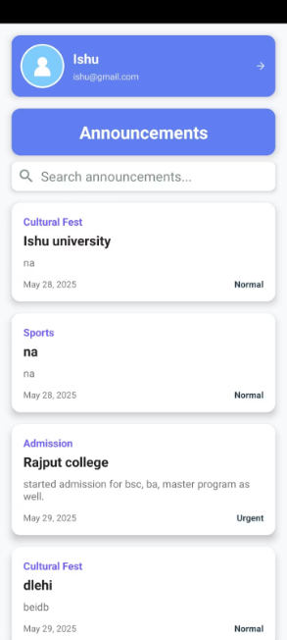
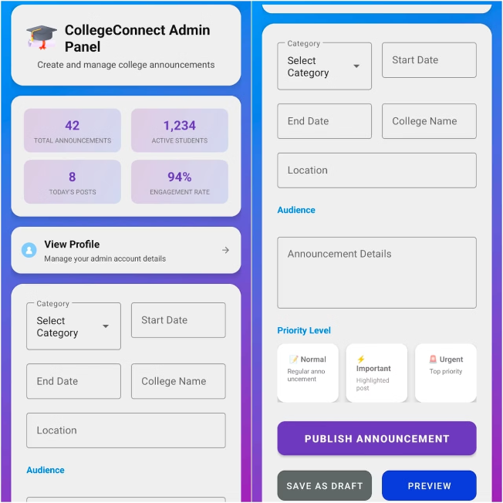
App Screenshots
Student Profile
Admin Profile
Student Announcement Section
Admin Panel

Slide 8

Quick Setup Guide
Clone Repository
From GitHub: github.com/IGNOUDuomates/CollegeConnect
Open in Android Studio
Version 4.2+, sync Gradle project.
Configure Firebase
Add google-services.json, enable Auth & DB.
Run Application
On Android device or emulator (API 21+).
OR
Install the Apk File of App From Releases Section of Repo.

Slide 9





Team & Contact
Ishu
Shubham Kumar
GitHub
Lead Developer
Backend Developer
Ishu9560439430@gmail.com
shubhamkumar730360@gmail.com

Slide 10

Ready for HackVortex 2025!
2025
30
1
HackVortex Year
Submission Date
Unified Platform
Round 1 Submission
May 30, 2025
CollegeConnect Goal
Thank you for your time and consideration.

